Slide 1
A Machine Learning based Approach to Forecast Hierarchical Time Series using Non-linear Mappings
We propose a non-linear forecast reconciliation approach using machine learning methods
We introduce a novel loss function incorporating non-linear mappings to obtain a set of coherent forecasts from the individual base forecasts.
To obtain the weights of the non-linear mapping between the base forecasts, we train a feed-forward neural network with the proposed loss function using fitted values of the base models as inputs to the network.

Slide 2
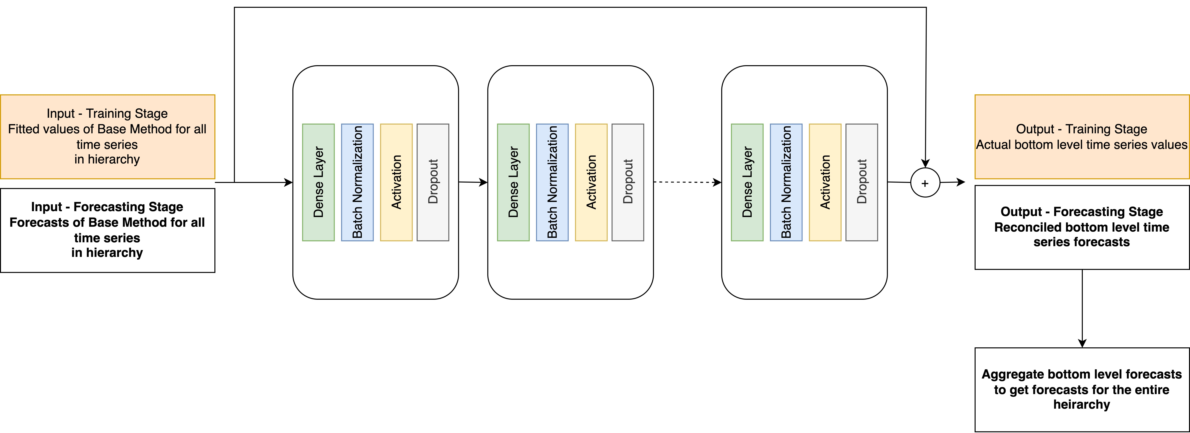
Proposed Reconciliation Network
$$Training loss=bottom level prediction error+ λ ∗reconcilation error$$

Slide 3
Data
Dataset | Frequency | Number of levels | Number of total time series | Horizon | Short Horizon
Prison | 4 (quarterly) | 5 | 121 | 8 | 4
Tourism | 12 (monthly) | 3 | 85 | 12 | 6
Wikipedia | 7 (weekly) | 6 | 1095 | 7 | 3
Labour | 4 (quarterly) | 4 | 57 | 12 | 6

Slide 4
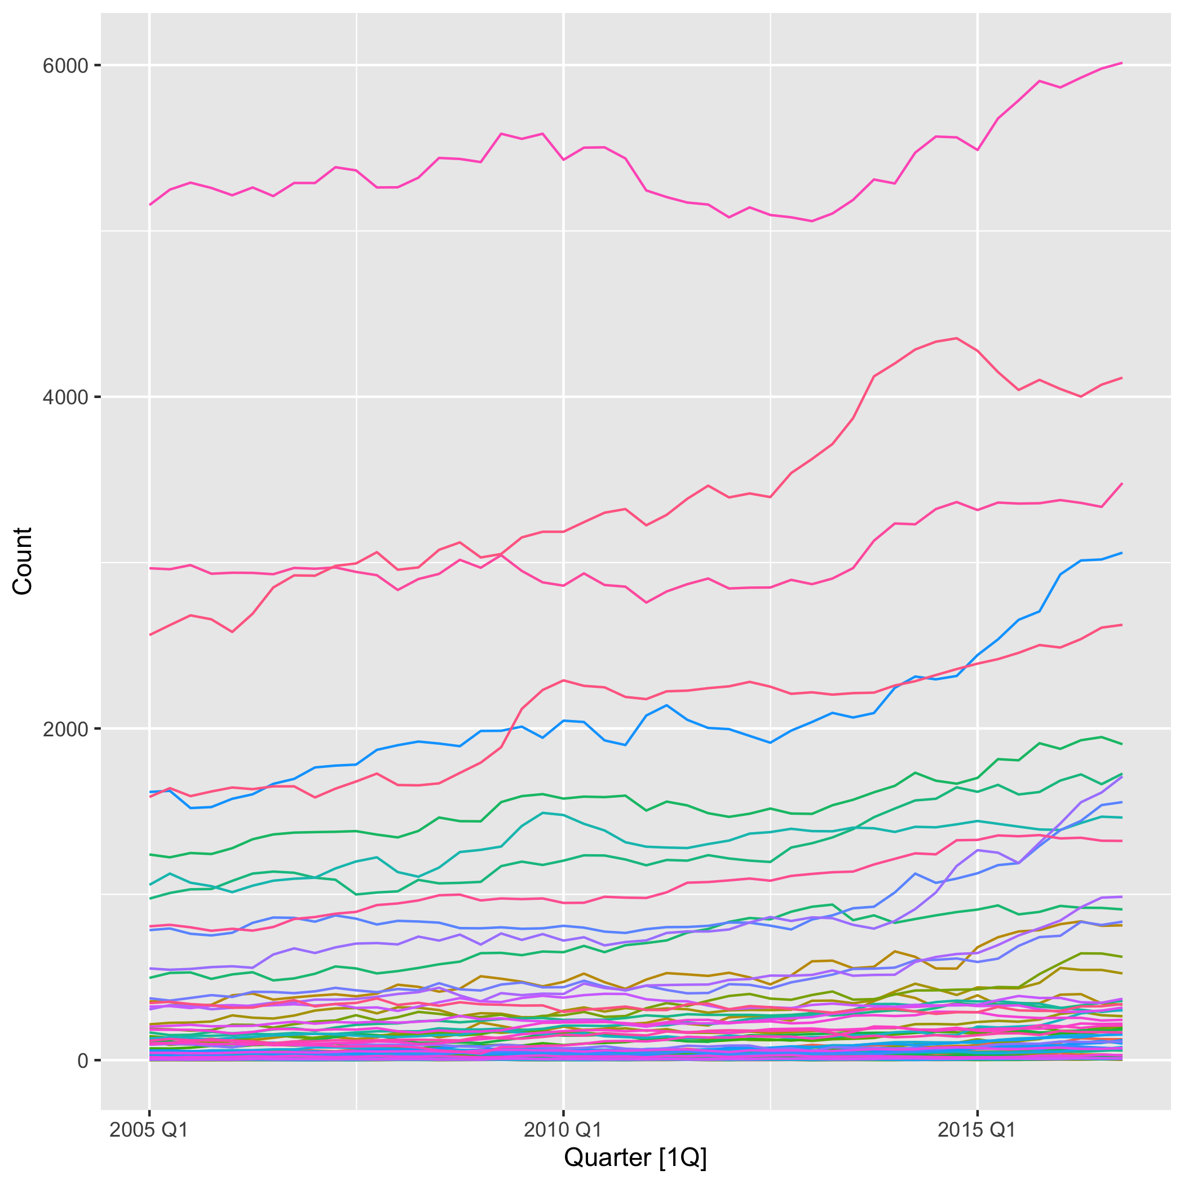
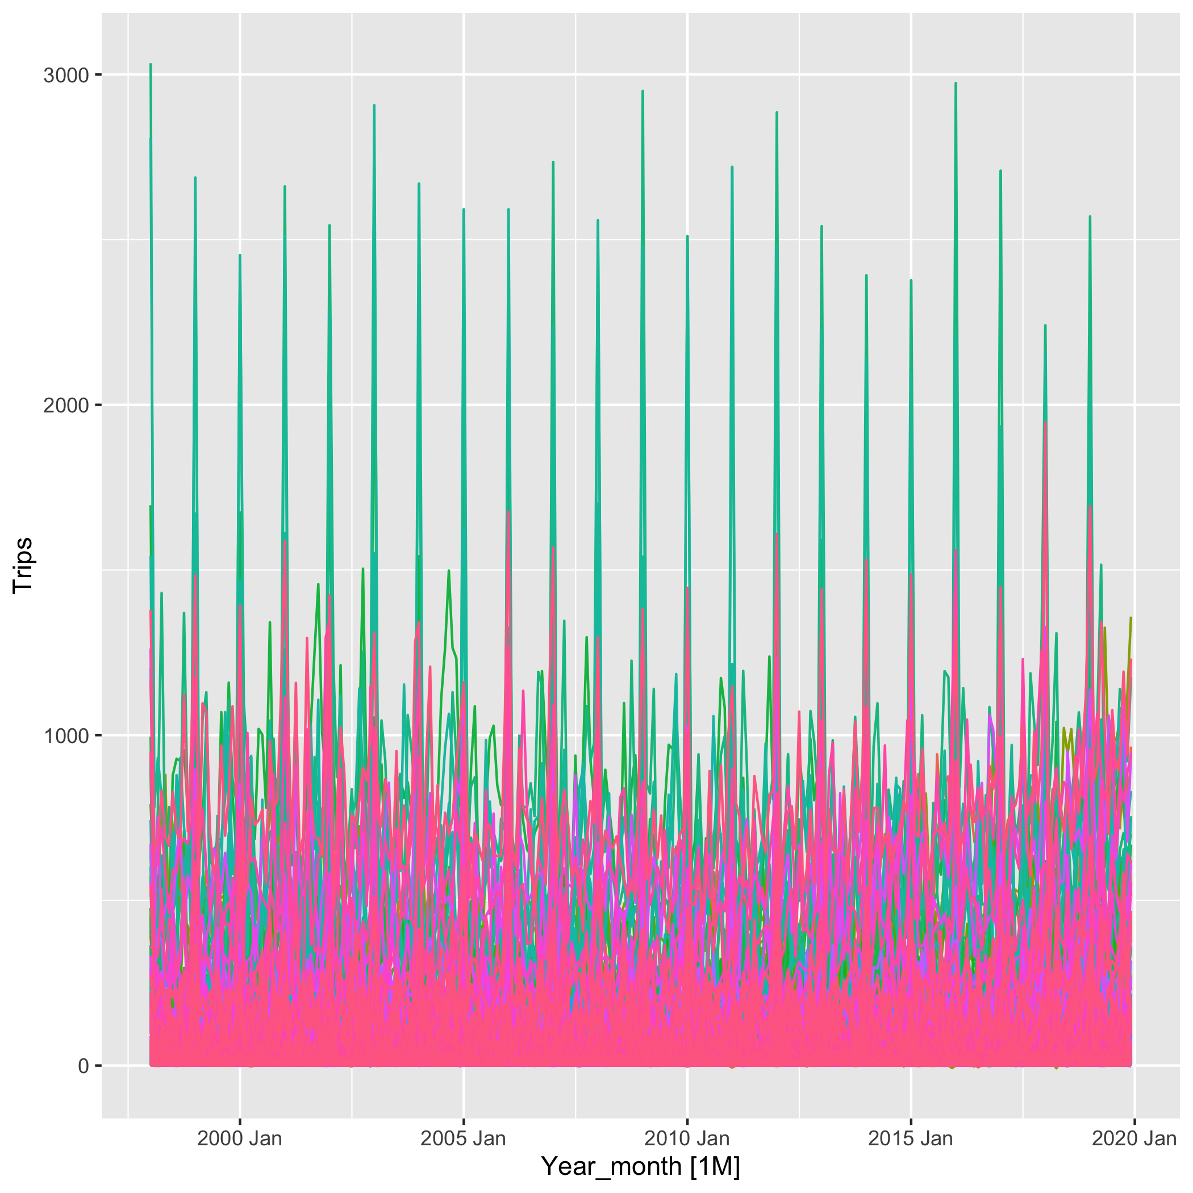
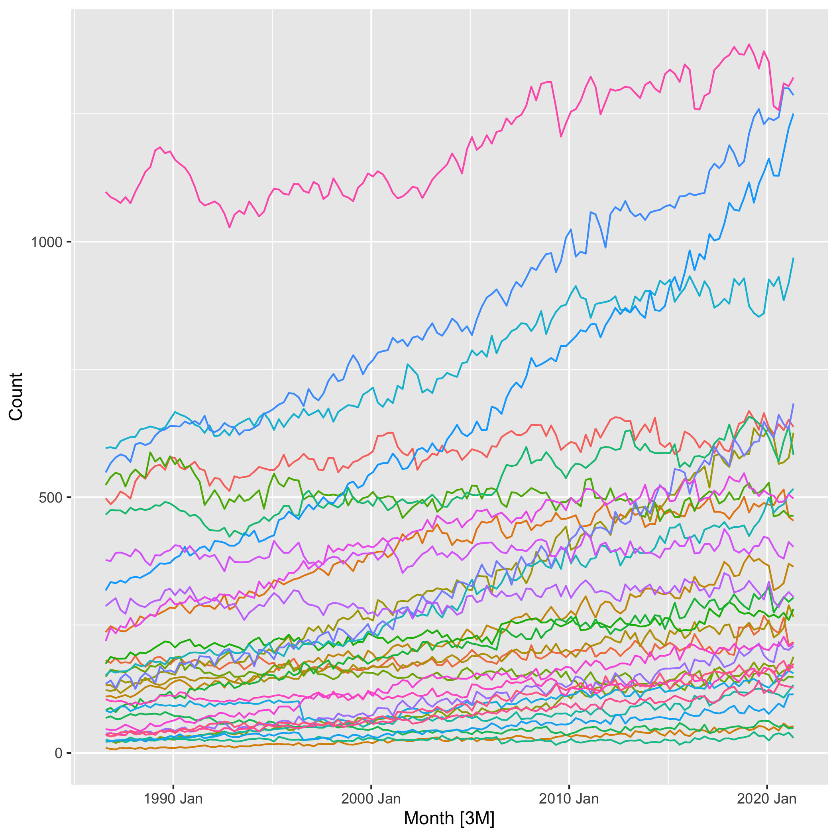
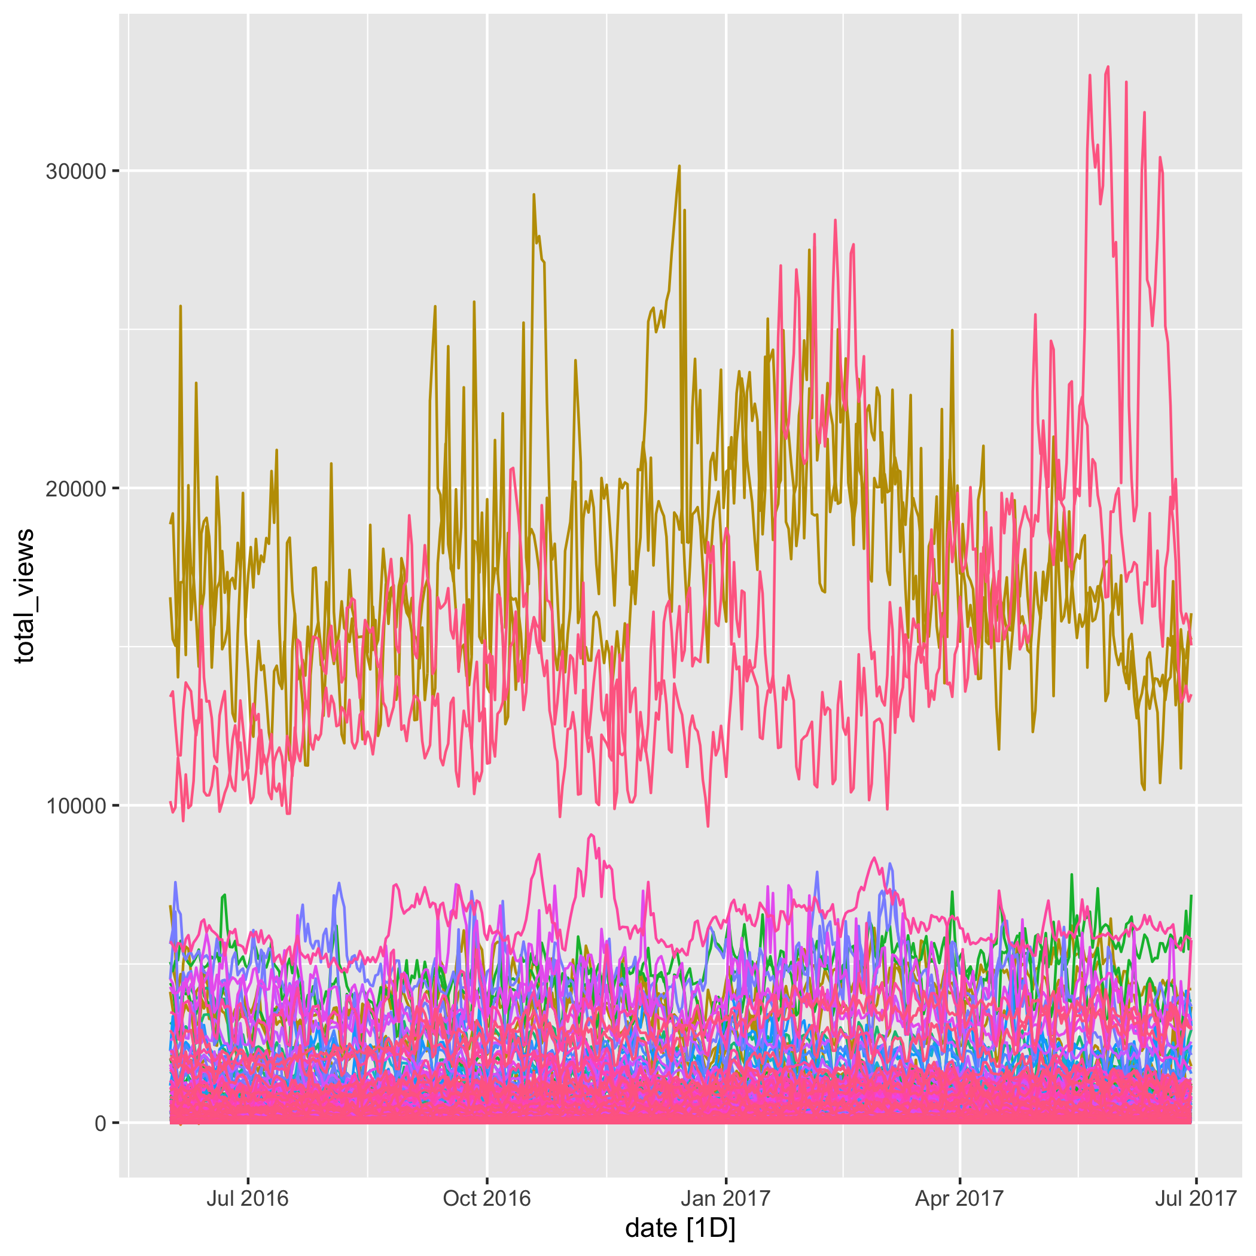
Data
Prison
Tourism
Labour
Wikipedia

Slide 5
Experimental Setup and Evaluation
Base forecasting methods:
ARIMA
ETS
DeepAR
WaveNet
The proposed ML Reconciliation mehtod is trained five times with different seeds and the average across these are taken as the final reconciled bottom level forecast
Benchmark Reconciliation Methods:
Bottom Up
OLS
WLS
ERM
MinTShrink
MinTSample
DeepAR and WaveNet methods are trained as Global Models
To develop the Global Models – all time series in the hierarchy are clustered using K-mean algorithms and a DeepAR/ WaveNet model is built for each cluster
We conduct an expanding window evaluation for all datasets. Based on the length of the time series in the datasets the following number of windows are created per dataset
Univariate Model
Global Models
Dataset | Number of windows | Minimum training window length
Prison | 3 | 24
Tourism | 10 | 144
Wikipedia | 10 | 324
Labour | 5 | 68

Slide 6
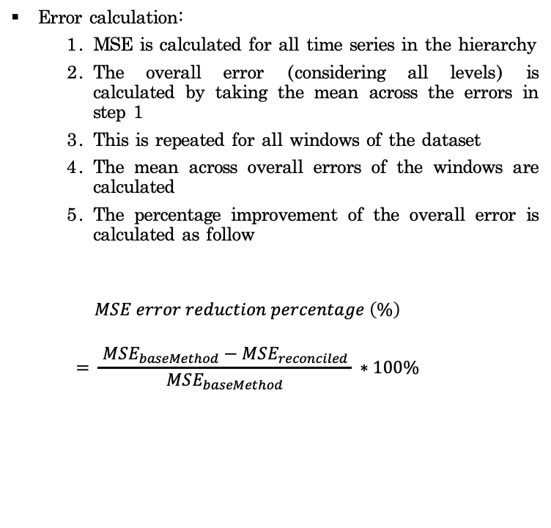
Experimental Setup and Evaluation
Error calculation:
MSE is calculated for all time series in the hierarchy
The overall error (considering all levels) is calculated by taking the mean across the errors in step 1
This is repeated for all windows of the dataset
The mean across overall errors of the windows are calculated
The percentage improvement of the overall error is calculated as follow
$$MSE error reduction percentage \left(\%\right)$$
$$= \frac{ MSE_{baseMethod}−MSE_{reconciled }}{MSE_{baseMethod}} ∗100\%$$
Hyper-parameters of the ML reconciliation method are tuned with HyperOpt – Bayesian Optimization
Hyper-parameter | Minimum | Maximum
Number of Layers | 1 | 5
Dropout Rate | 0 | 0.5
Learning Rate | 0.0001 | 0.1
Number of Epochs | 10 | 200
Batch Size | 1 | Size of input data
Max Norm | 0 | 10
Lambada (Reconciliation Loss) | 0.01 | 5

Slide 7
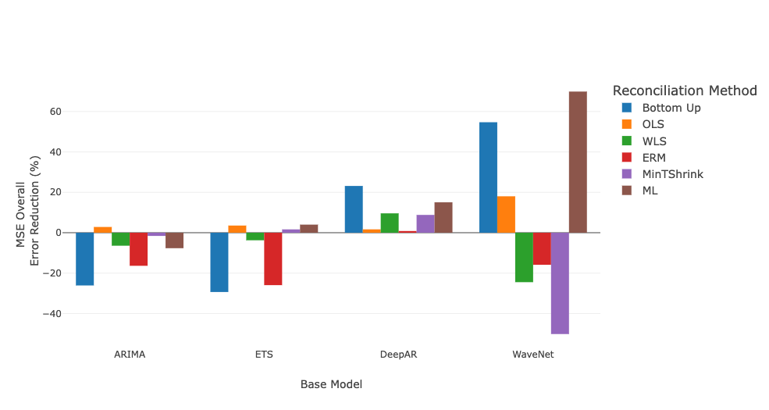
Results – Prison Dataset
ARIMA | ETS | DeepAR | WaveNet
OLS | ML Reconciliation | Bottom UP | ML Reconciliation

Slide 8
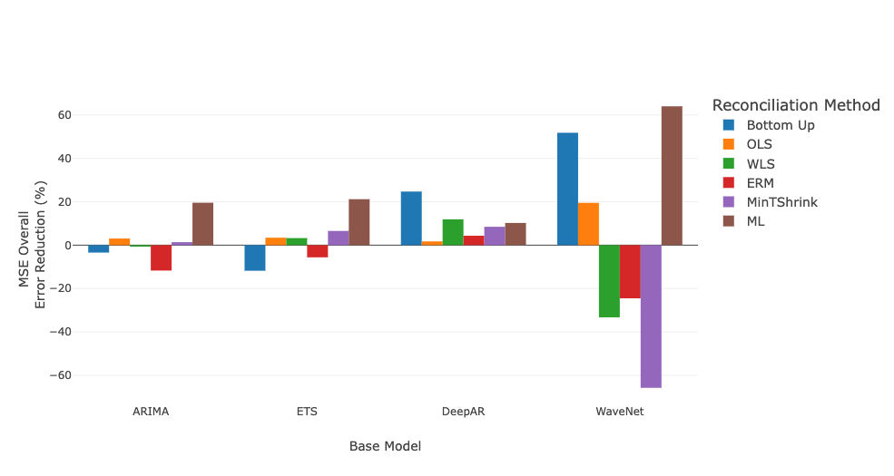
Results – Prison Dataset (Short Horizon)
ARIMA | ETS | DeepAR | WaveNet
ML Reconciliation | ML Reconciliation | Bottom UP | ML Reconciliation

Slide 9
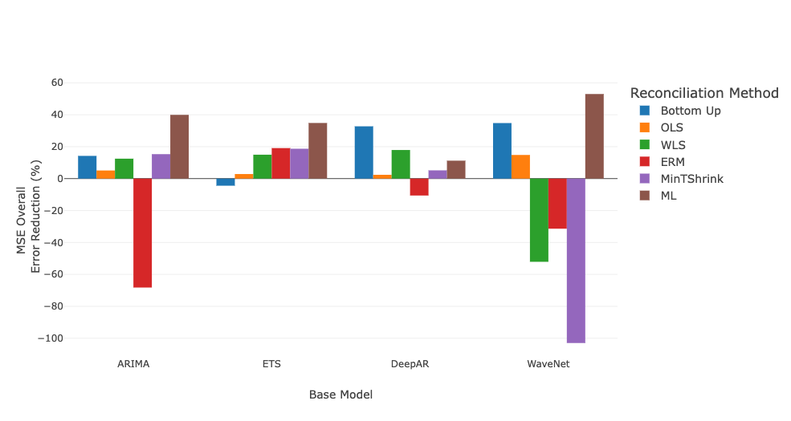
Results – Prison Dataset (One step Horizon)
ARIMA | ETS | DeepAR | WaveNet
ML Reconciliation | ML Reconciliation | Bottom UP | ML Reconciliation

Slide 10
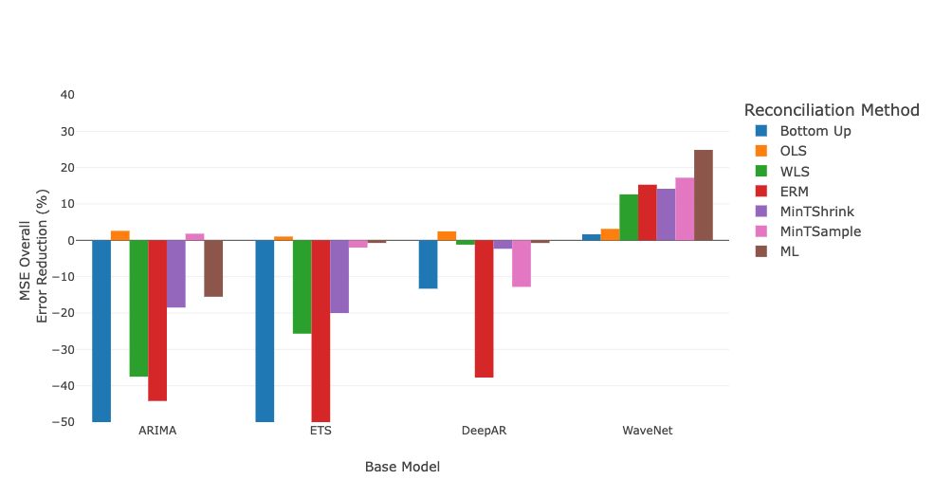
Results - Tourism
ARIMA | ETS | DeepAR | WaveNet
OLS | OLS | OLS | ML Reconciliation

Slide 11
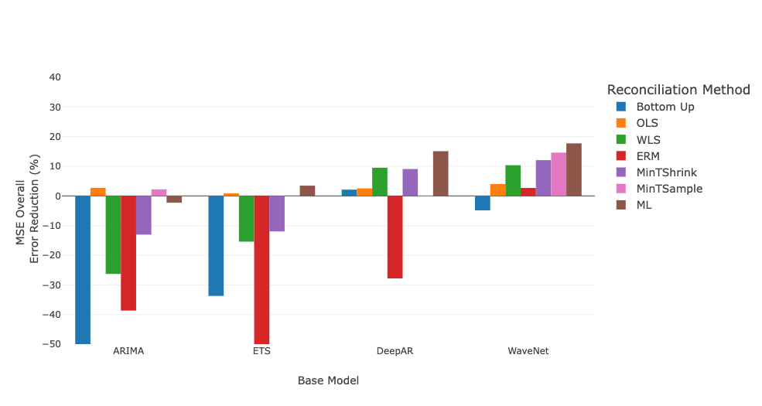
Results – Tourism (Short Horizon)
ARIMA | ETS | DeepAR | WaveNet
OLS | ML Reconciliation | ML Reconciliation | ML Reconciliation

Slide 12
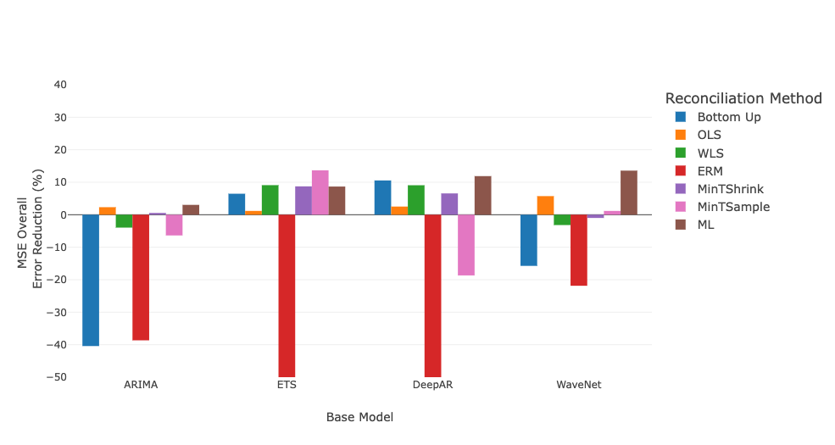
Results – Tourism (One step Horizon)
ARIMA | ETS | DeepAR | WaveNet
ML Reconciliation | MinT Sample | ML Reconciliation | ML Reconciliation

Slide 13
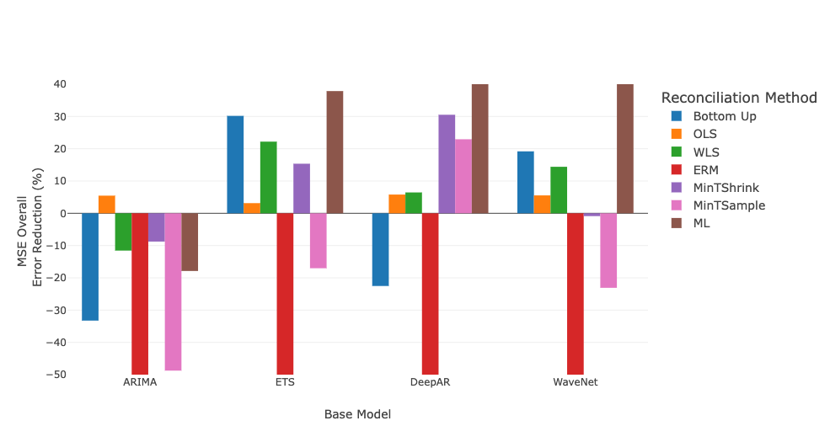
Results - Labour
ARIMA | ETS | DeepAR | WaveNet
OLS | ML Reconciliation | ML Reconciliation | ML Reconciliation

Slide 14
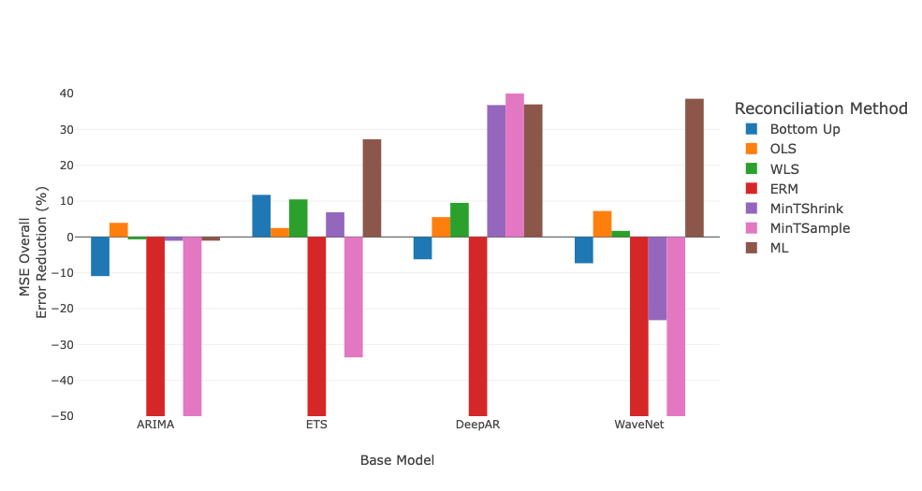
Results –Labour (Short Horizon)
ARIMA | ETS | DeepAR | WaveNet
OLS | ML Reconciliation | MinTSample | ML Reconciliation

Slide 15
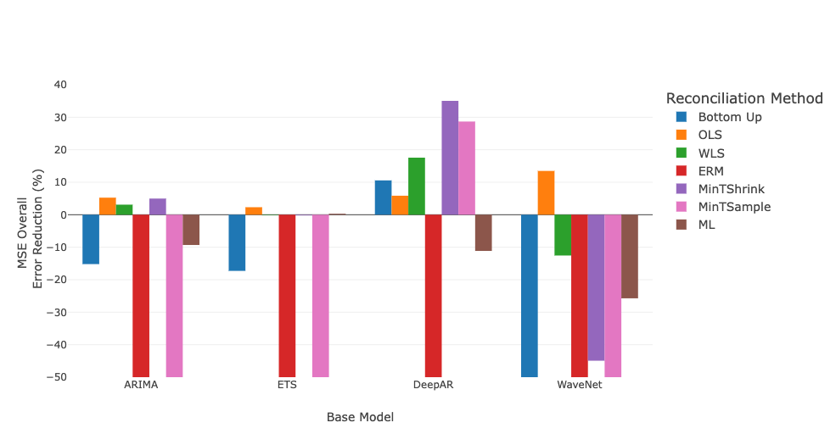
Results - Labour (One step Horizon)
ARIMA | ETS | DeepAR | WaveNet
OLS | OLS | MinTShrink | OLS

Slide 16
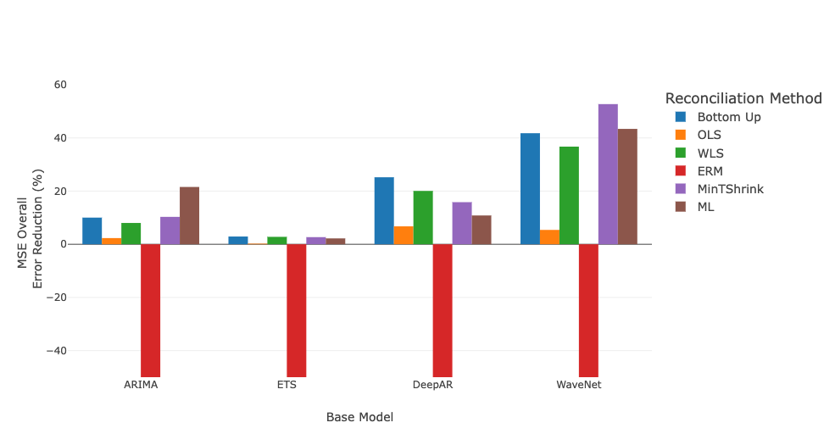
Results - Wikipedia
ARIMA | ETS | DeepAR | WaveNet
ML Reconciliation | Bottom Up | Bottom Up | MinTShrink

Slide 17
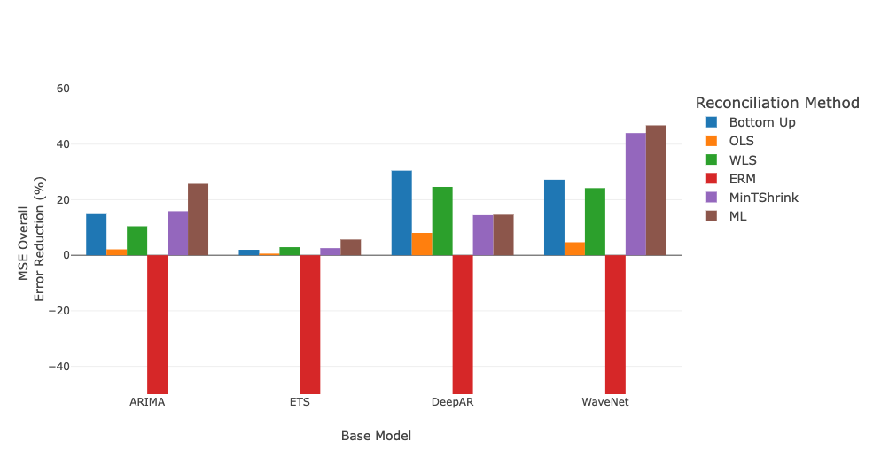
Results - Wikipedia (Short Horizon)
ARIMA | ETS | DeepAR | WaveNet
ML Reconciliation | ML Reconciliation | Bottom Up | ML Reconciliation

Slide 18
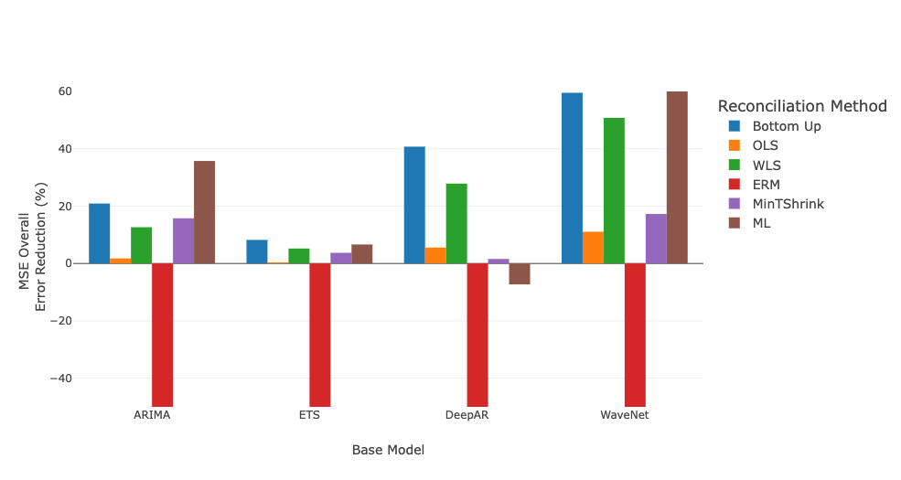
Results - Wikipedia (One step Horizon)
ARIMA | ETS | DeepAR | WaveNet
ML Reconciliation | Bottom Up | Bottom Up | ML Reconciliation

